Slide 1
<3 w/ vi[m]
180976
pg.0 ♥ w/ vi[m]

Slide 2

rules for the session…
#1 thanks for your time!
this session may go up to 2 hour
grab your drinks/snacks
#2 no recording plz –
turn-off the recording
recording leads less interaction
no playback – so sharp your focus
#3 ask more questions ; there’s no dumb qn
#4 i’ll share this slides later
#5 contents/screenshots/memes
created by self
fully copyleft; feel free to share/reuse
pg.1 ♥ w/ vi[m]

Slide 3

myth vs truth
hey kesavan, stop your nonsense - why i’ve to love this old vim ?
  i’ve 21st century modern editors – with GUI – graphics
  vim is old ; vim is so bore ; vim is complex
  quitting vim is impossible
  vim is colorless
  vim users are hackers
  vim triggers suicide thinking;
you should love vim, because
  vim cares you
  vim makes your life better
  vim is so powerful
  vim is solid; elder to GNU/Linux
  vim is colorful
  vim makes you a better dev &
  to become a hacker, you must be a dev
designed by myself! License : copyleft
(Ͻ)Kesavan Muthuvel
pg.2 ♥ w/ vi[m]

Slide 4
checklist – my assumption
vim8
  on your TUI terminal user interface – GNU/Linux
  on your GUI graphical user interface - Windows
basic OS skill
  familiar with novice commands: cd ls cp mv rm on TUI
  file navigation & management over explorer on GUI
That’s it;
  You’re admitted!
pg.3 ♥ w/ vi[m]

Slide 5
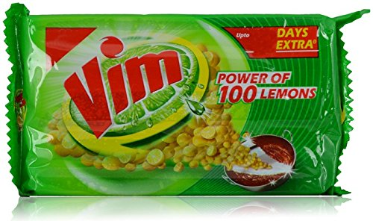

vim is everywhere!
yes,
  vim is on every kitchen
  and on every GNU/Linux distro
  BSD’s, Solaris, *nix or whatever most server runs on…
powerful vim!
to start w/ vim
  go to your kitchen $home terminal
  command `vim`
pg.4 ♥ w/ vi[m]

Slide 6
welcome onboard … seat belt please !
#1 terminal lovers are [cr|l]azy ; so be crazy & lazy .. few commands/terminology
cat - concatenate
ls - list
mark - bookmark
#2 vim has 3 modes or 2 modes or I-don’t-know honestly ; but
  always ESCape to get into normal – file is read only
  key in i/a/o for insert/append/open - file ready for write
  :command from normal - follow the command
#3 if vim is not listening you, enforce it !
! – don’t ask me any question
! - don’t report any error/waring
! – just ( do-or-die )
#4 " - is for commenting in vim world
:e – (re)load / (e)dit – in case if you need to reload
examples
w! – force write
bd! – force buffer delete
q! – quit vim, no questions
pg.5 ♥ w/ vi[m]

Slide 7
:part #1 “basics
smile always
go to ground
play the game
guard your data
enjoy the break
pg.6 ♥ w/ vi[m]

Slide 8
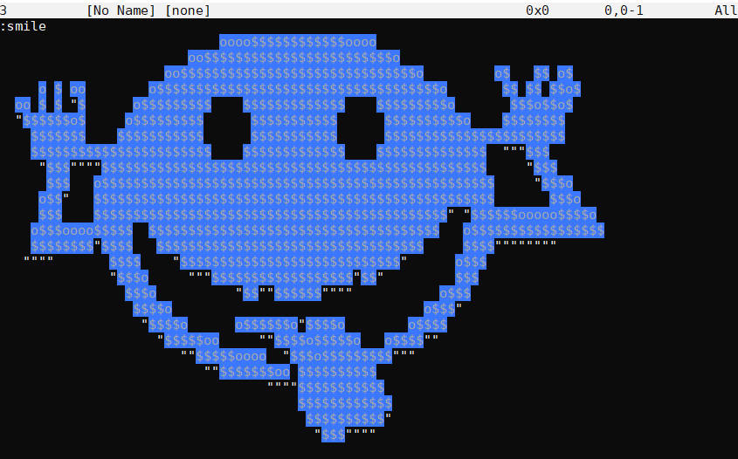
start w/ smile ☺
:smile “makes you happy
pg.7 ♥ w/ vi[m]

Slide 9

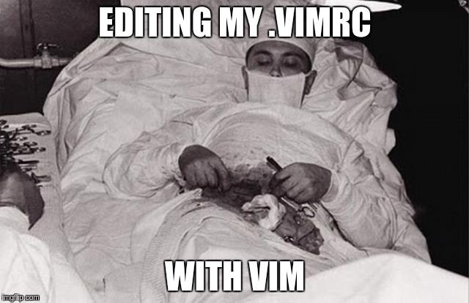
go to the ground: ~/.vimrc
my 1st config
vim secret …sshH!
lets have some fun :)
Has own handbook –.vimrc - vim runtime config
  train your vim ; tailor your vim
  hack it! break it! fix it!
generally located on home dir :
  ~/ GNU/Linux,BSDs, Solaris
  C:\Users/<xxx>/ MS Windows
regular way:
$vi ~/.vimrc
set number “set line numbers
lazy way:
$vi ~/.vimrc
se nu “set line numbers
key key(s)
i “ into insert mode #1
“ make changes #2
ESC “ to normal mode #3
:w “ write to file #4
:q “ quit the file #5
!! Bonus !!
:source % “ load current file(%) as config
:wq “ write & quit , remember to be lazy
pg.8 ♥ w/ vi[m]

Slide 10
recipe secret …sshH!
play the game ~/.vimrc
"key stuff
set number " set line numbers
set nocompatible " use vim defaults (much better!)
set history=500 " save history
set bs=2 " allow backspace
set laststatus=2 " show status line in 2 last rows
syntax on " turn on syntax
set directory=~/.vim/tmp " tell vim where’s the tmp dir
set undodir=~/.vim/undo-dir " and also history of changes
set undofile " track my changes
"search
set hlsearch " highlight the search results
set incsearch " incremental the search results
set ignorecase " ignore case ; include all cases
set smartcase
"file encoding & type def
set enc=utf-8
set fileencoding=utf-8
set fileencodings=ucs-bom,utf8,prc
set paste
filetype on
filetype plugin on
filetype indent on
" stop insert asap
autocmd VimEnter * stopinsert " stop insert mode when enter
set noinsertmod " normal mode than insert
little more fun !
as easy as dosa
preheat tawa
spread wet mixed flour
stretch to near round
sprinkle oil
pack when golden color
search tips
/ search pattern forward
? search pattern backward
n next occurrence
N previous occurrence
# find word under cursor forward
* find word under cursor backward
pg.9 ♥ w/ vi[m]

Slide 11
they‘re watching...
people love to watch on other’s room. keep your data away from preying eyes.
Want to share secret files over mail to colleagues but not to company ?
soln: always follow `x` when comes secret
$vi –x my_secret.txt # from terminal
:X “ from vim
[de|en]crypt files using vim’s own algorithm.
share the key to your friend; unlock w/ the private key
warning: not a strong algorithm; breakable; fair to use
pg.10 ♥ w/ vi[m]

Slide 12
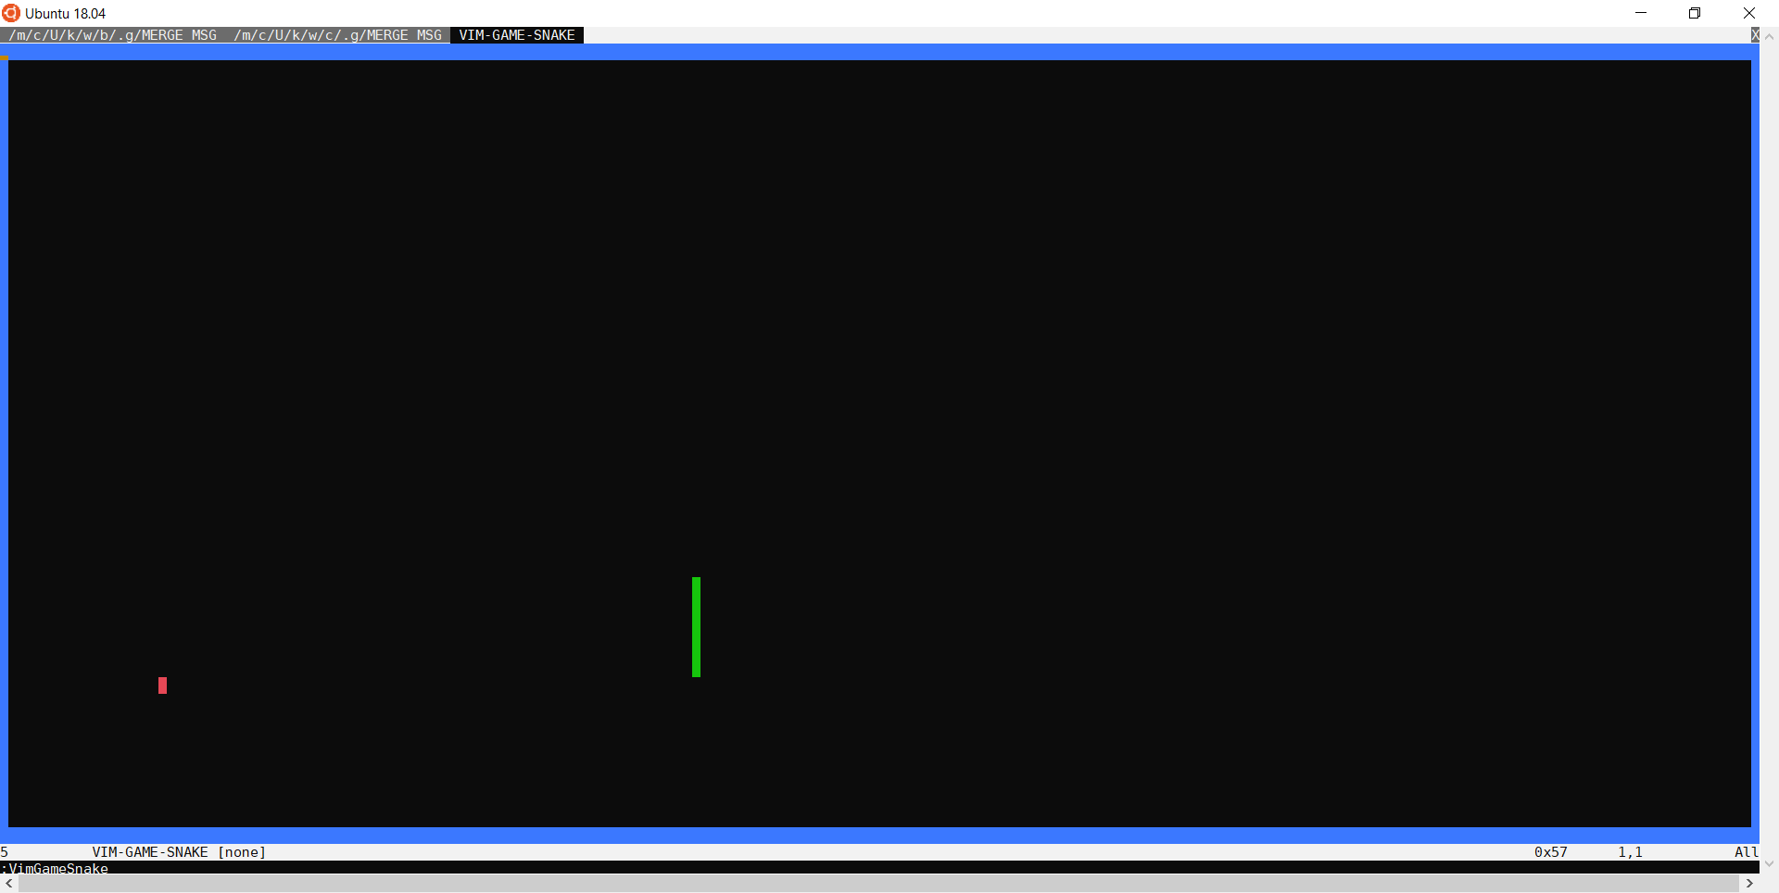
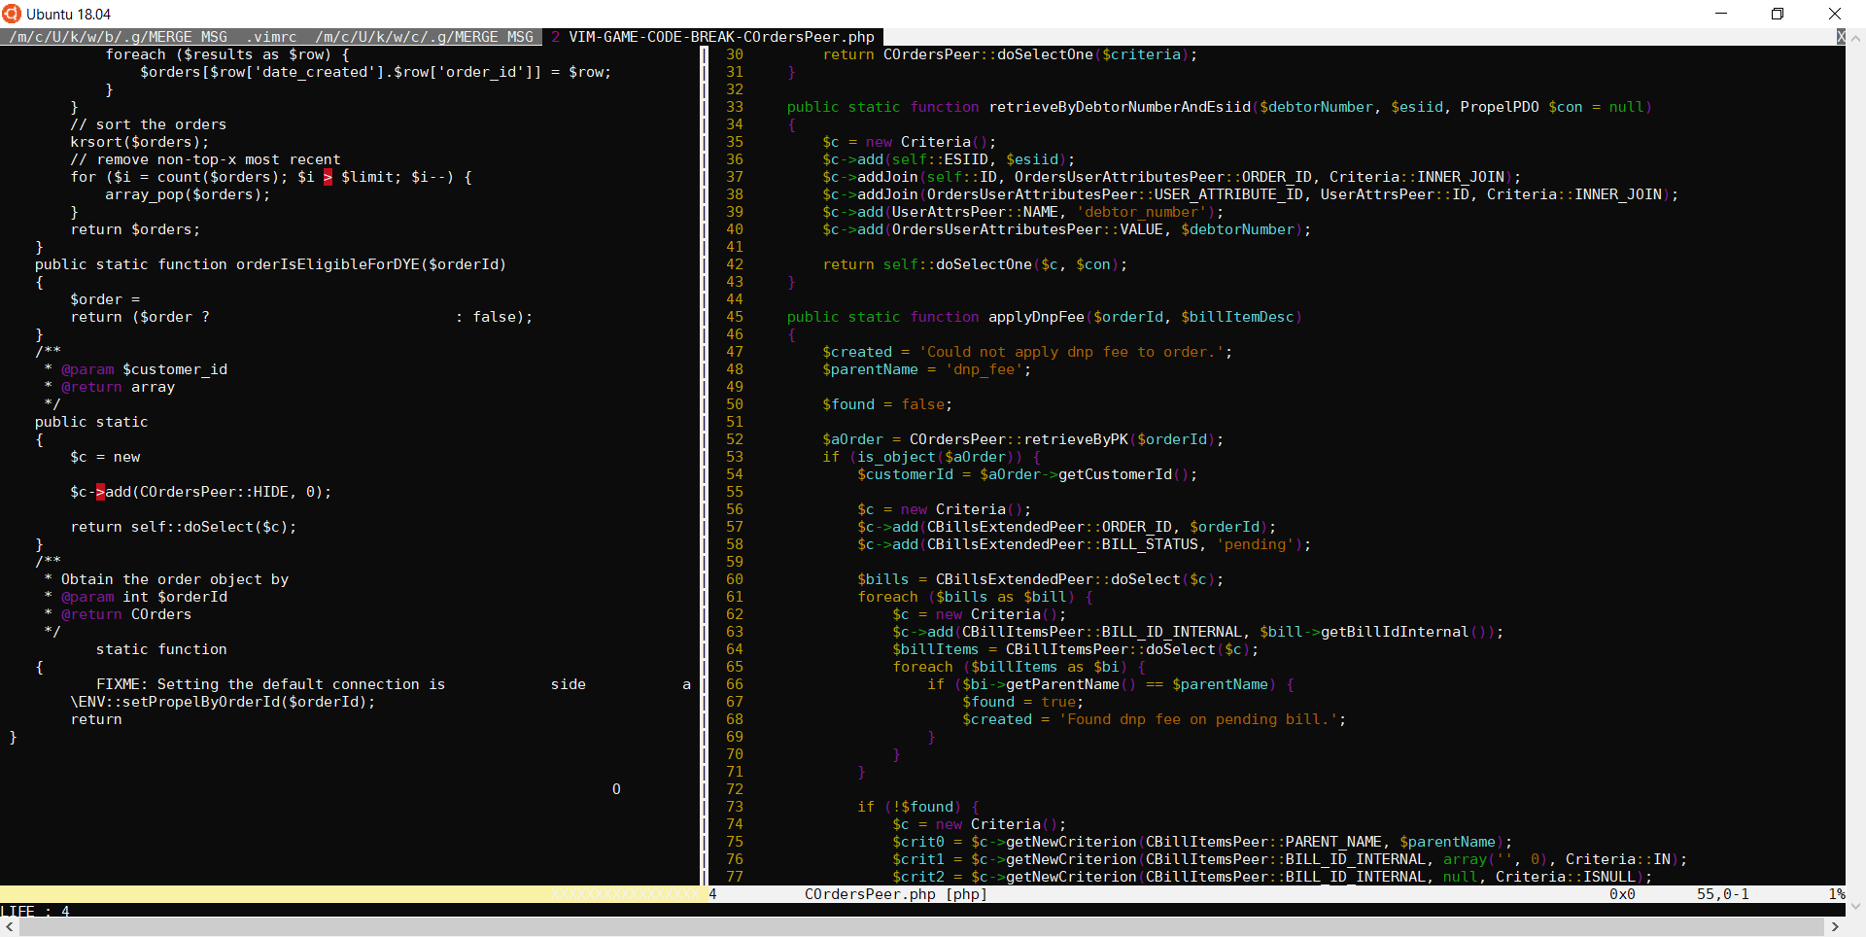
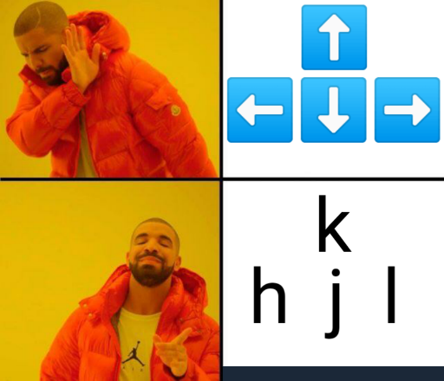
breaktime... or plugin time!
#1 add a plugin manager ; below is my fav
download plug.vim & place under ‘autoload’ dir inside ~/.vim dir
#2 that’s it! restart vim ;
#3 check your plugin manager
:PlugInstall
:VimGame...
call plug#begin('~/.vim/plugged')
Plug 'johngrib/vim-game-snake’ “ 90kids game
Plug 'johngrib/vim-game-code-break’
call plug#end()
pg.11 ♥ w/ vi[m]

Slide 13
:part #2 “keys, strikes, xUI, candies
little cute mice
mark’ thy words
registers” thy clips
color the rainbow
terminal vs vim
pg.12 ♥ w/ vi[m]

Slide 14
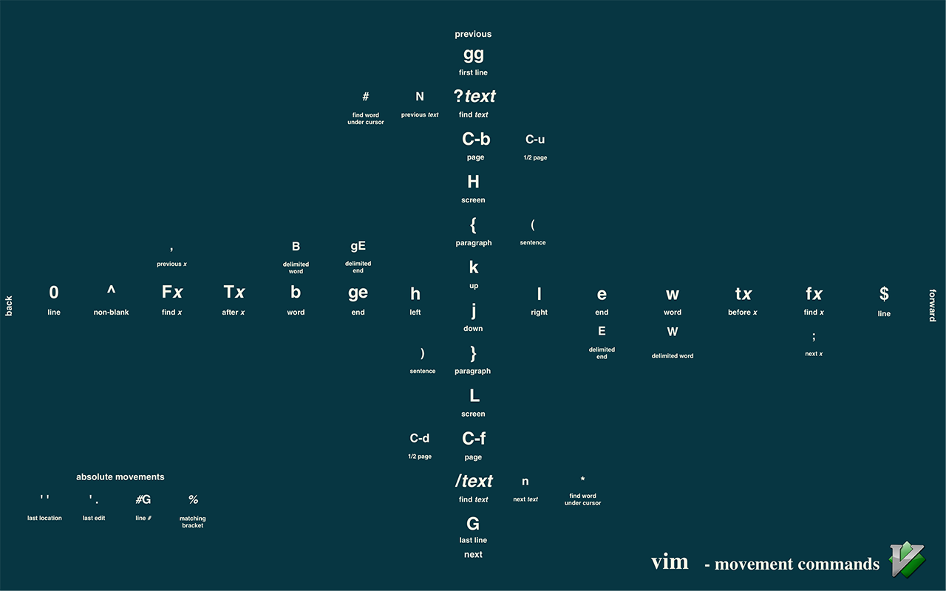
keyboard or mouse?
vim ♥ keyboard, but never hate little mouse
there’s no mouse in era of vim
and people were happy with keyboard
now start practice w/ highlighted keys
:set mouse=a " vim loves keyboard, but never mouse
:set ttymouse=sgr " and this is modern mouse
pg.13 ♥ w/ vi[m]

Slide 15
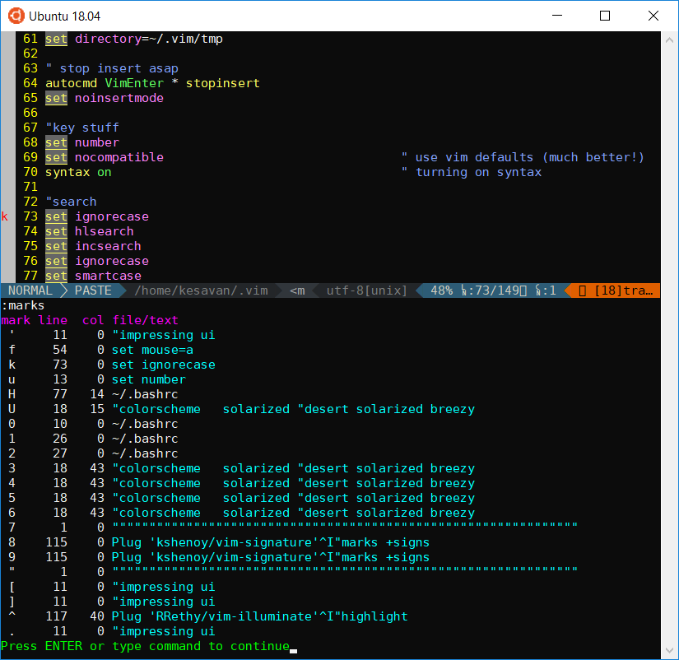
mark’ thy words
always, mark your words - ~ bookmarks
:marks “ list all your bookmarks
m[a-zA-Z0-9] “ mark a buffer position w/ a char
'x “ single quote: jump to line – marked as x
`x “ backtick: same above but jump to line + col
a-z “ local marks
A-Z “ global marks
Plug 'kshenoy/vim-signature' " enjoy visual marks ☺
jumps - sometime people land nowhere & lost their way
‘. “ jump to last position
CTRL-o & CTRL-i “ jump to old/new position
:jumps “ show all my way to past
pg.14 ♥ w/ vi[m]

Slide 16
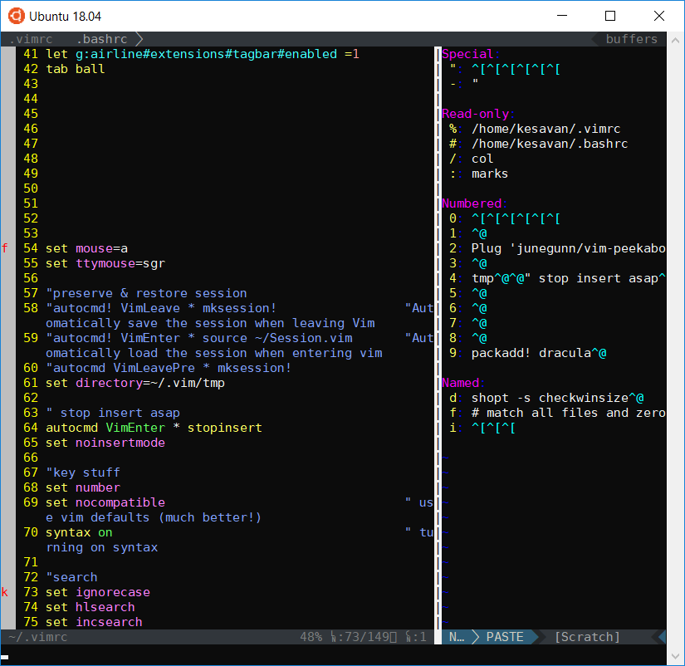


register” thy clips
Don’t forget register sweet memories - ~ clips
:registers “list all your clips
:reg “lazy version
" “ last copied content
0-9 “ deleted registers
a-z “ user named registers
"fy “ yank selection into f NORM MODE
"xp “ paste contents from x NORM MODE
ctrl-r 5 “ paste contents from 5 INS MODE
In VIM world , it’s yank & paste
Plug 'junegunn/vim-peekaboo' " enjoy visual registers ☺
extra slide at the appendix on registers. Yank/paste person? you’ll find all your fav shortcuts
pg.15 ♥ w/ vi[m]

Slide 17
colors & candies – enjoy the rainbow
vim is vibrant & colorful – let’s add color to rainbow
curved fonts + colorful theme + right config = beautiful vim
set t_Co=256 " support more terminal colors
set guifont=DejaVu\ Sans\ mono:h9
syntax enable
colorscheme desert " add flavor to your taste
" color colo as good!
set cursorline " where I’m in this island
set colorcolumn=80 " try not to cross the border
" glow in night
Plug 'RRethy/vim-illuminate’ " illuminate the variables
" strawberry over vanilla cream
Plug 'vim-airline/vim-airline'
Plug 'vim-airline/vim-airline-themes’
" bring more themes
Plug 'altercation/vim-colors-solarized'
Plug 'fneu/breezy'
Plug 'dracula/vim'
if exists(":AirlineRefresh")
:AirlineRefresh
endif
let g:airline_theme='breezy' " gruvbox simple seagull
let g:airline_powerline_fonts = 1
let g:airline_section_b = '%{getcwd()}'
"TABLINE:
let g:airline#extensions#tabline#enabled = 1
let g:airline#extensions#tabline#tabs_label = 'tabs'
let g:airline#extensions#tabline#buffers_label = 'buffers'
let g:airline#extensions#tabline#fnamemod = ':t'
let g:airline#extensions#tabline#show_tab_count = 1
let g:airline#extensions#tabline#show_buffers = 1
let g:airline#extensions#tabline#tab_min_count = 1
let g:airline#extensions#tabline#show_splits = 1
let g:airline#extensions#tabline#show_tab_nr = 1
let g:airline#extensions#tabline#show_tab_type = 1
let g:airline#extensions#tagbar#enabled =1
tweaks for OS:
$sudo apt install fonts-powerline
pg.16 ♥ w/ vi[m]

Slide 18
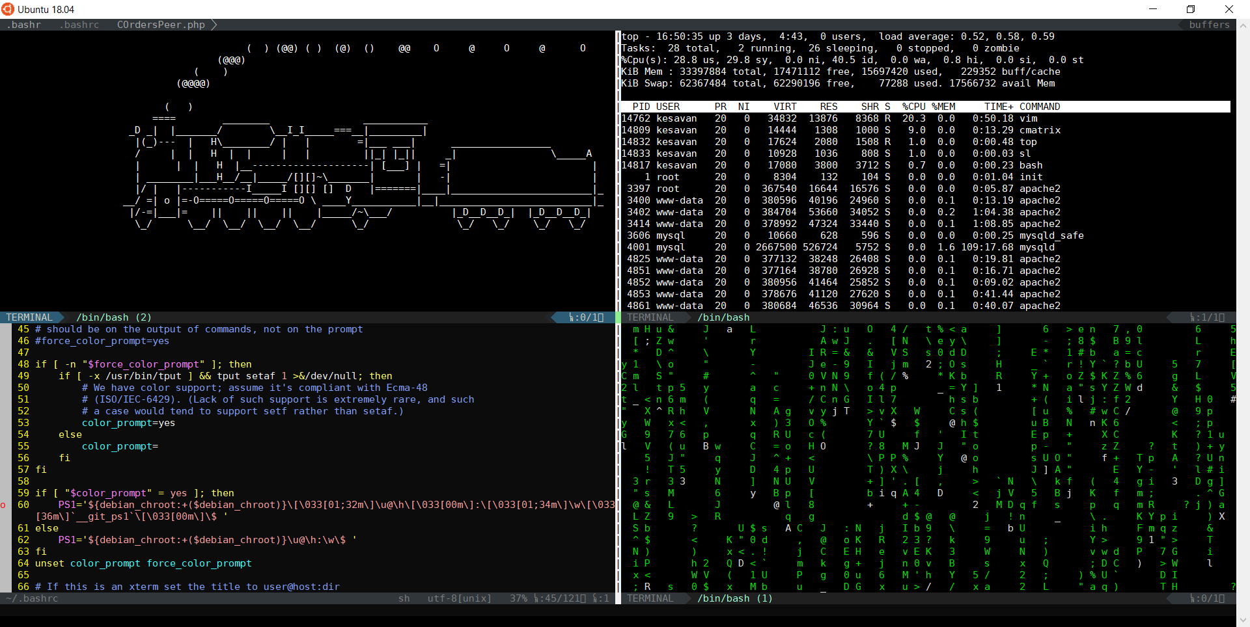
run the engine from vim
want to execute some command on OS? don’t quit vim; there’s no escape!
fall into matrix ; follow the white rabbit
:terminal :term “ open the gateway to other realm
:vertical bel terminal “ vertical terminal on right side bel - below
sudo apt install sl
sudo apt install cmatrix
pg.17 ♥ w/ vi[m]

Slide 19
:part #3 “buffers windows tabs
watch the street
handle more buffers
break the windows
fix with tabs
save your space
pg.18 ♥ w/ vi[m]

Slide 20
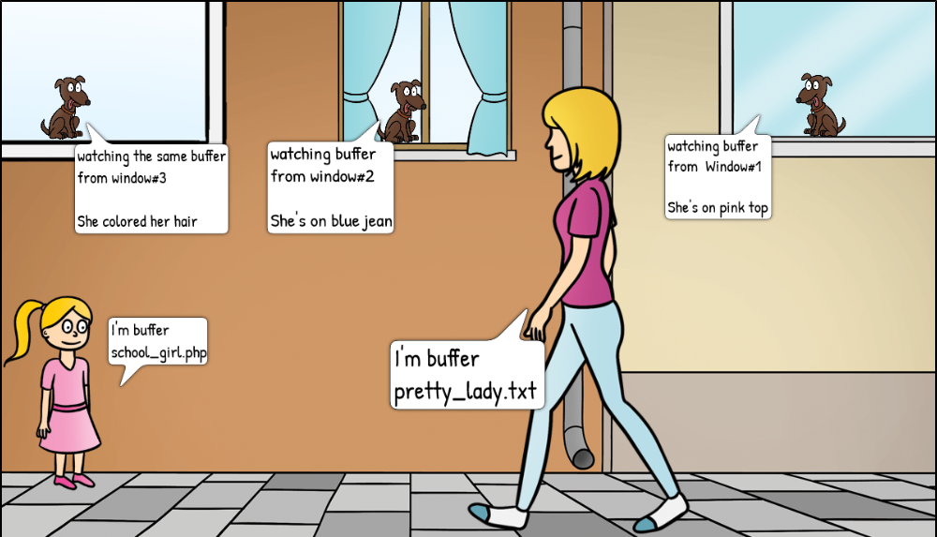
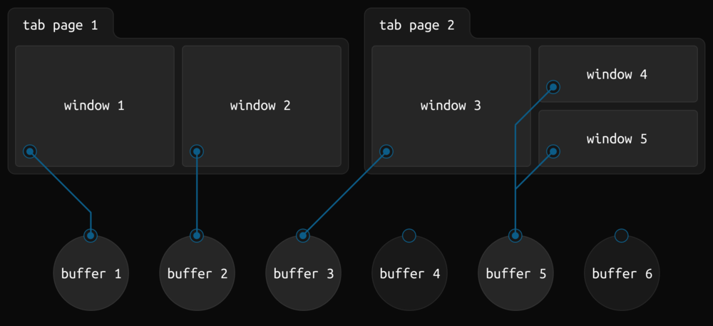
let’s watch buf from wintab
buffer – file in memory – ready for r/w operation
  saving buffer is writing into physical file at OS level
  multiple buffers can be opened, parallelly!
window – view port to watch buffers
  a window can be used to look after multi buffers
tabpage – hold one or more window
  collections of windows ;
  manage the workspace
commands to handle multi files operations
buffer – bufdo
window – windo
tab – tabdo
:bufdo %s/foo/bar/g
– substitute foo w/ bar all buffers
:windo %s/foo/bar/g
substitute foo w/ bar on buffers in current window
tab – tabdo
designed by myself! License: copyleft (Ͻ)Kesavan Muthuvel

Slide 21
handle more w/ buffers; yes, you can!
buffer – file in memory – ready for r/w operation
$vi abc.txt xyz.php pq.js # handle more files
$vi * # load all files
:buffers :ls :files – list all buffers w/ <id>
:bn[ext] - buffer next
:bp[revious] - buffer previous
:bf[irst]/bl[ast] - buffer first/last
:b xy - buffer xy.php; w/ auto-complete
:b# - buffer w/ id
pg.20 ♥ w/ vi[m]

Slide 22
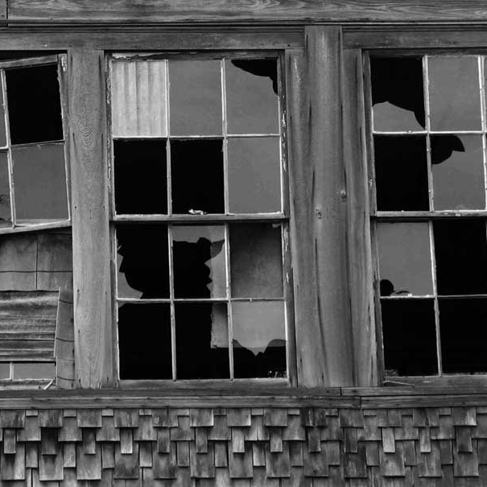

break the windows
window – just a view port to look over buffer
- closing window doesn’t close the buffer
- buffer still loaded on vim
window commands are starts with ctrl-w
  c-w s - split window horizontally :split :sp
  c-w v - split window vertically :vsplit :vs
  c-w w - switch to other window ( clockwise)
  c-w >< - adjust the horizontal width
  c-w +- - adjust the vertical height
  c-w q - quit the window :quit q
  c-w o - quit all windows, keep this only :only :on
  :windo – execute commands on all open windows
exercise #todo
:belowright vertical terminal
:aboveleft vertical terminal
pg.21 ♥ w/ vi[m]

Slide 23

fix w/ tabs
tab page – collection of windows & buffers
- grouping mech to keep one tab for related files
- tab is more GUI friendly; your mice love tabs
:tab ball " open all buffers in separate tabs*
:tabo " tabs into buffers
:tabs – list all open tabs
:tabnew - open new tab page
:tabnext - tab page next
:tabp[revious] - tab page previous
* :set tabpagemax=99 "allow more tabs
pg.22 ♥ w/ vi[m]

Slide 24


save your workspace
keep all your opened tabs & windows layouts
reload all previous settings for buffers/vim
:mksession ~/Session.vim “make session -~/Session.vim
:source ~/Session.vim “load session
- much useful in GUI; for 2K kids who look for modern experience
"preserve & restore session
autocmd! VimLeave * mksession! " save the session when leaving
autocmd! VimEnter * source ~/Session.vim " load the session when entering
autocmd VimLeavePre * mksession!
pg.23 ♥ w/ vi[m]

Slide 25

:part #4 “explore, travel, search, repeat
explore local ground
discover external space
fuzz the finder
grep goes rip
travel against time
xkcd.com/1522 CC
pg.24 ♥ w/ vi[m]

Slide 26
explore the world
handling multiple jobs? busy w/ high demand ?
always explore outside world from vim with:
:Ex - tmp explore & work in existing window
:Sex - tmp explore & work in new horizontal window
:Vex - tmp explore(left) & work in vertical window
:Lex - permanent explorer on Left – modern look
:Tex - quick mode – tab version
:Rex - Return to explorer
! does reverse when comes with exploring
:Ex! - :Ex in vertical split
:Sex! - same of :Sex, but vertical
:Vex! - right :Vex
:Lex! - keep it Right
:Tex! - NOT Allowed
:Rex! - NOT Allowed
:help Explore
:[N]Explore[!] [dir]... Explore directory of current file :Explore
:[N]Hexplore[!] [dir]... Horizontal Split & Explore :Hexplore
:[N]Lexplore[!] [dir]... Left Explorer Toggle :Lexplore
:[N]Sexplore[!] [dir]... Split&Explore current file's directory :Sexplore
:[N]Vexplore[!] [dir]... Vertical Split & Explore :Vexplore
:Texplore [dir]... Tab & Explore :Texplore
:Rexplore ... Return to/from Explorer :Rexplore
Used with :Explore **/pattern : (also see netrw-starstar)
:Nexplore............. go to next matching file :Nexplore
:Pexplore............. go to previous matching file :Pexplore
pg.25 ♥ w/ vi[m]

Slide 27
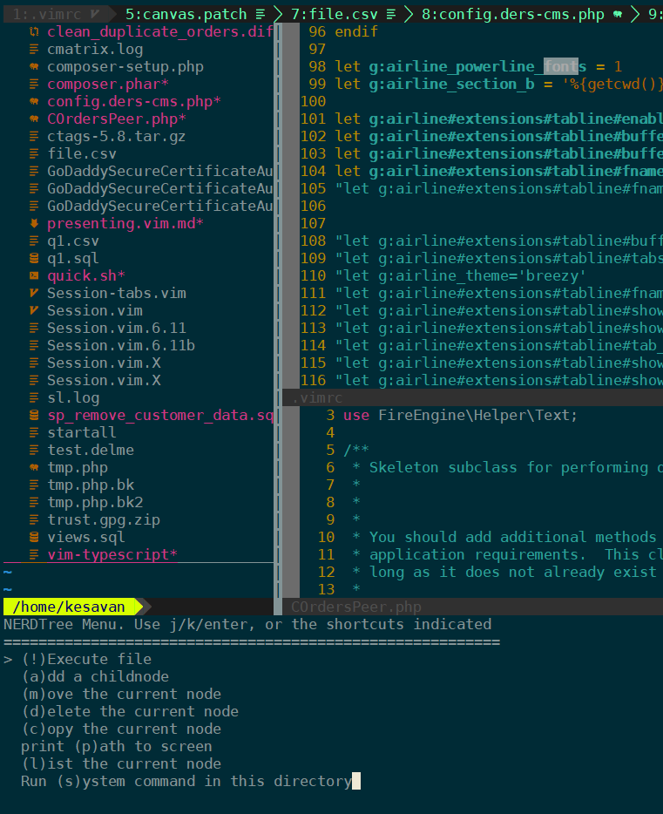

discover external space
another better tool to discover more stuff - NERDTree
Plug 'preservim/nerdtree’ " explorer
Plug 'ryanoasis/vim-devicons' " icons
autocmd BufWinEnter * silent NERDTreeMirror " mirror it
O - open file in new buffer
t - open file in new tab
s - open file vertical split
i - open file horizontal split
file management made easy
multiple files ? no problem
love visualization? yes it is!
(B)ookmark those key files
m " menu offers quick file operations!
B " show bookmarks
:Bookmark " bookmark the file within NerdTree
pg.26 ♥ w/ vi[m]

Slide 28
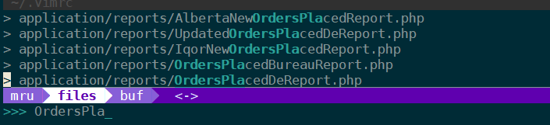
fuzzy find Ctrl-P
Ctrl-P – unlock the MRUs/buffers/files ... index’m all
Plug 'ctrlpvim/ctrlp.vim’ " Ctrl-P
ctrl-p " open the fuzzy finder
ctrl-o " open file
ctrl-t " open file in new tab
ctrl-z " (un)mark to open multi files
ctrl-b or ctrl-f – " switch between buffers/mru/files
" mru : most recent used
pg.27 ♥ w/ vi[m]

Slide 29
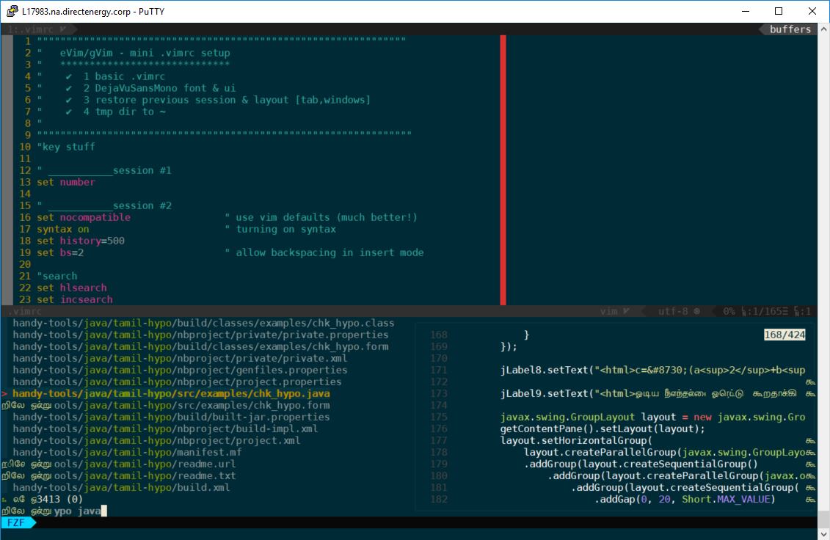

grep vs vimgrep vs rg … fzf!
Vim has it’s own search tool – vimgrep/vimgrepadd
/findme "search & highlight the pattern
/[cC]Order "search & highlight the regex
:% s/idly/dosa/gc "substitute idly with dosa
"search all buffers
:execute “bufdo vimgrep /needle/ %” | copen " search & pop in quick list
:cexpr [] " cleanup quick list
:cclose or :q (from quick-list) " close quick-list*
Plug 'jeetsukumaran/vim-buffersaurus’ " lets grep the needle, easy/lazy
:Bsgrep <pattern> " grep the pattern across the buffers
try ripgrep(rg) – faster than grep. Also install bat over cat
$sudo add-apt-repository ppa:x4121/ripgrep # from terminal
$sudo apt install bat ripgrep
"get that rocket engine
Plug 'junegunn/fzf.vim' " fzf <3 vim
Plug 'junegunn/fzf',{ 'do': { -> fzf#install() } } " fzf binary
:Files " find for files
:Rg " find in files
:Buffers " list :buffers
pg.28 ♥ w/ vi[m]

Slide 30

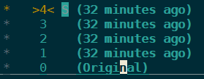

travel against time
Vim has built-in time machine , yes!
You can forward to your past or back to future as you want.
All you need is to ensure you’ve undodir & undofile set in place
:earlier 30s " forward to past 30 sec
:later 1h " back to future 1 hour
:ea 5d " forward to past 5 days
:lat 7f " move to 7th future state
s/m/h/d – sec/min/hr/day f - file writes
let vimDir = '$HOME/.vim'
let &runtimepath.=','.vimDir
if has('persistent_undo’)
  let myUndoDir = expand(vimDir . '/undodir’)
  " Create dirs
call system('mkdir ' . vimDir)
call system('mkdir ' . myUndoDir)
let &undodir = myUndoDir
set undofile
endif
short form
" time machine – it’s already there
set undodir=~/.vim/undo-dir
set undofile
Plug 'mbbill/undotree' " travel time
:UndotreeShow " reborn in past
pg.29 ♥ w/ vi[m]

Slide 31
:part #6 “vim-as-an-ide
repeat some nonsense
compare that data
edit it vertically
view the x-ray
vim as debugger
pg.30 ♥ w/ vi[m]

Slide 32
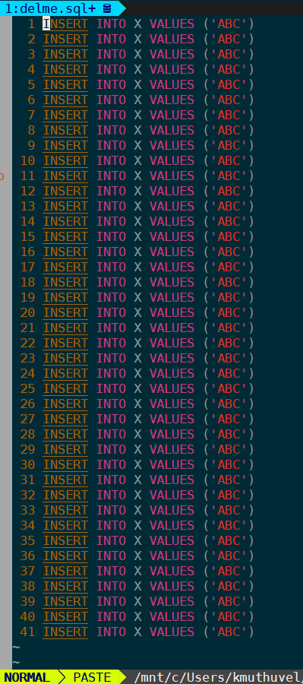
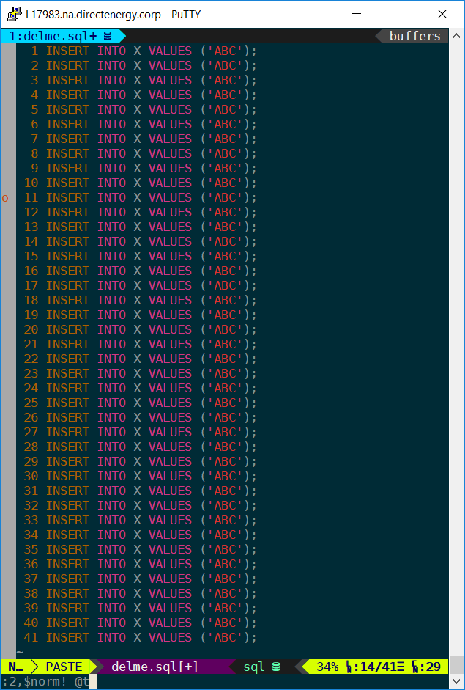

repeat those nonsenses
macro – record this ; play forever
:q{your letter}{series of commands}q
to record: q<alphanum>
to stop : q to quit
apply on lines matching pattern :g/pattern/normal! @a
apply on next 100 lines :100@a
apply on from lines 34-65 :43,65normal! @a
apply on all lines :%norm! @a
sample#1: append ; at EOL
recording – qt$A;<ESC>q
playing - 2,$norm! @t
to record: q<alphanum> actions q
to repeat: :norm! @<alphanum>
sample#2: delete empty lines
recording – :qx dd <ESC>q
playing - :g/^$/norm! @x
pg.31 ♥ w/ vi[m]

Slide 33
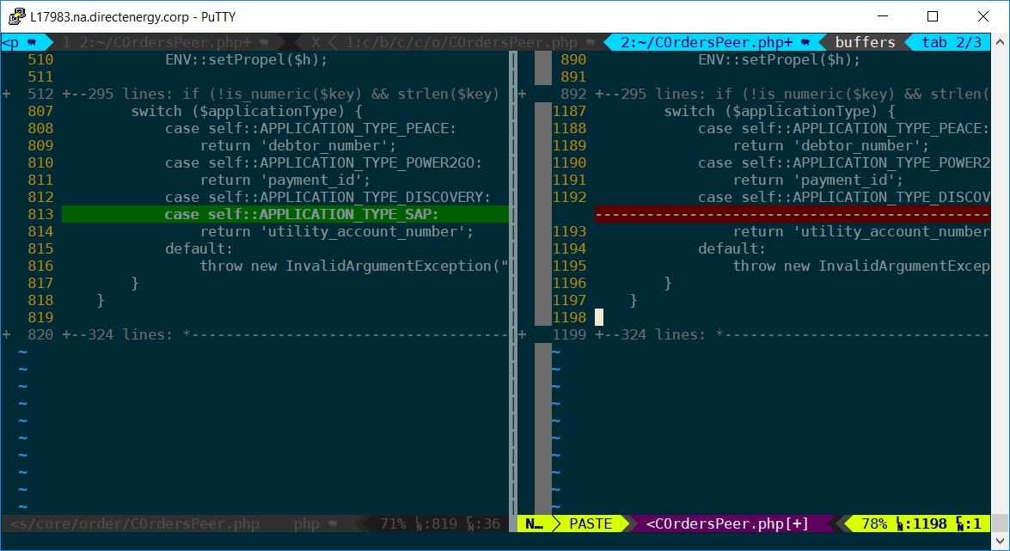


vimdiff - always compare & decide
looks alike ? compare before choose!
hl DiffAdd cterm=BOLD ctermfg=NONE ctermbg=22
hl DiffDelete cterm=BOLD ctermfg=NONE ctermbg=52
hl DiffChange cterm=BOLD ctermfg=NONE ctermbg=23
hl DiffText cterm=BOLD ctermfg=NONE ctermbg=23
always compare
$vim -d abc.txt abcd.txt
]c - next diff
[c - prev diff
do - diff obtain
dp - diff put
zi - toggle fold
windo :diffthis
windo :diffupdate
pg.32 ♥ w/ vi[m]

Slide 34
run up/down, not just back/forth
edit your job in vertical (column) mode
ctrl-v - select the columns
I - Insert
r - replace
d - delete
c - change/edit
pg.33 ♥ w/ vi[m]

Slide 35
on hurry burry? no time to unzip?
vim has xray eyes ; it can play on compressed items. so finish your task in quick way
$vim something.zip archive.tar.gz #from terminal
  will list archived files
  which you can edit/save without extracting
  supported archives: tar.gz, tgz, zip, etc
pg.34 ♥ w/ vi[m]

Slide 36

vim as debugger
vdebug can help you debug the code directly from vim
but it too early now ; next session
and too much plugins === too much of makeups
pg.35 ♥ w/ vi[m]

Slide 37
:part #x “goals, recap, extra bonus
<3 w/ vi[m]

Slide 38
free-bonus
" buffer navigation - shortcuts
" Ctrl Left/h & Right/l cycle between buffers
let mapleader = "\<Space>“
noremap <silent> <C-left> :bprev<CR>
noremap <silent> <C-h> :bprev!<CR>
noremap <silent> <C-right> :bnext<CR>
noremap <silent> <C-l> :bnext!<CR>
noremap <silent> <S-S> :Files<CR>

Slide 39

buffers v2
buffer – file in memory – ready for r/w operation
$vi abc.txt xyz.php pq.js “ handle more files
$vi * “ load all files
:buffers :ls – list all buffers w/ <id>
:bn[ext] - buffer next
:bp[revious] - buffer previous
:bf[irst]/bl[ast] - buffer first/last
:b xy - buffer xy.php;
:b <id> - buffer w/ id
[d]elete vs [w]ipeout
dirty recap
:bd - deletes the current buffer, error if there are unwritten changes
:bd! - deletes the current buffer, no error if unwritten changes
:bufdo bd - deletes all buffers, stops at first error (unwritten changes)
:bufdo! bd - deletes all buffers except those with unwritten changes
:bufdo! bd! - deletes all buffers, no error on any unwritten changes
:bw - completely deletes the current buffer, error if there are unwritten changes
:bw! - completely deletes the current buffer, no error if unwritten changes
:bufdo bw - completely deletes all buffers, stops at first error (unwritten changes)
:bufdo! bw - completely deletes all buffers except those with unwritten changes
:bufdo! bw! - completely deletes all buffers, no error on any unwritten changes
:set confirm - confirm changes (Yes, No, Cancel) instead of error
:tabe +Nbuf - open buffer number N in new tab

Slide 40

register” thy clips w/ detail
yank | normal/visual | command | action/outcome
To local reg | y | :y | “yank selected into default reg(")
 | yy Y | :yy :Y | “yank line into default reg(")
 | "a-z0-9y | :ya-z0-9 | “yank into named/numbered reg
To OS reg | "*y | :y *+ | “yank into OS reg
To remote OS (PuTTY/SSH) | ALT+SHIFT LEFT CLICK |  | “and select the content “yank into remote OS memory
 | SHIFT LEFT CLICK |  | “and select the content (dirty) “yank into remote OS memory
 | :se mouse=c SELECT & left click |  | “set copy mode “yank into remote OS
 | registers & description
0 | last copied clip (yank only)
1-9 | numbered regs – FILO algorithm
a-z | named regs – associative array
" | last clip (cut/delete/yank)
* | gnu/mac/win OS memory
+ | gnu only special OS memory
INSERT mode – access the registers
<CTRL+r> 0-9a-z | paste reg content
<CTRL+r> = | quick vim calc’r
paste | normal/visual | command | action/outcome
From local reg | p P | :put | “paste from default reg; “(p)after / (P)before cursor
 | "a-z0-9p | :puta-z0-9 | “paste from named/numbered reg
From OS reg | "*+p | :put *+ | “paste from OS reg
From remote OS(PuTTY/SSH) | SHIFT RIGHT CLICK |  | “paste from REMOTE OS yank
COMMAND mode | CTRL-R " CTRL-R * |  | “from reg “from OS reg
pasting on command line :
<CTRL+r> " | paste default reg
<CTRL+r> = | quick vim calc’r
<CTRL+r> = | quick vim calc’r
" friendly right click menus
Plug 'kvngvikram/rightclick-macros'
" make it as a shortcut
:noremap y "*y

Slide 41
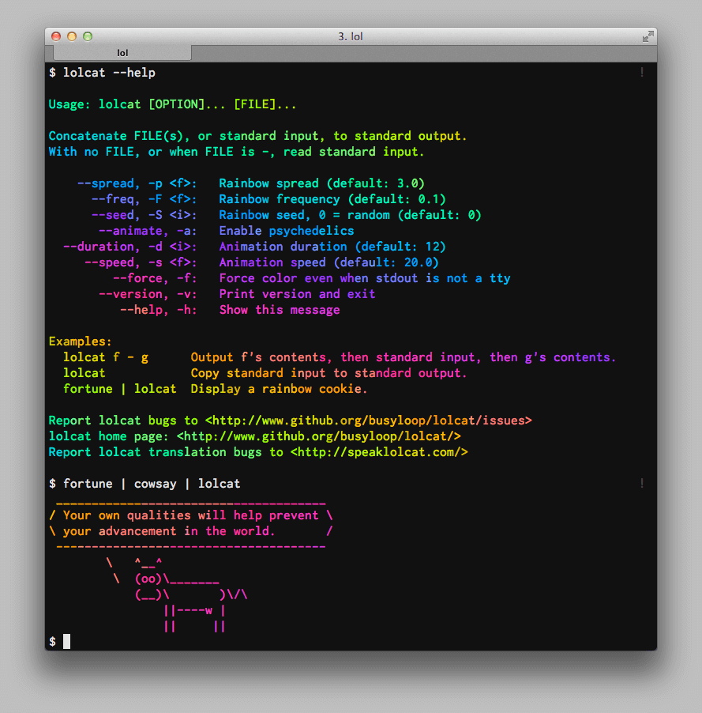

bonus #1
bring colors & flavors to your life
i too love black & white but colors are cool
lolcat
#add colors
#enjoy rainbow

Slide 42
bonus – keep an eye on jobs
running multiple jobs/threads ?
not sure who is the culprit to blame
kill that right zombie/daemon
find mother & her (original) daughters
ps auxwf | grep -B8 " [2]533 "
# display process table in GNU/Linux with
# parent/child relationships, searching
# for process id 2533

Slide 43
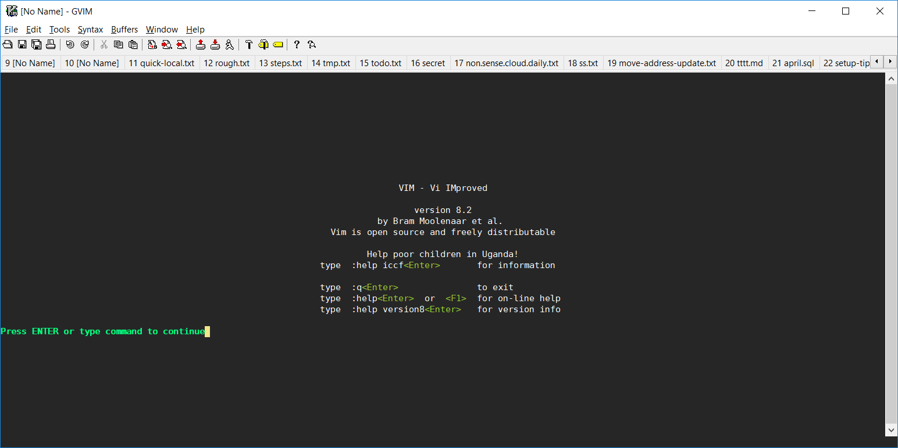
gVIM – sister of vim, GUI version
#1 - hope you’ve GUI gVIM ; start by calling it “gvim –y”
#2 – modern look ; exclusively for 2k kids

Slide 44
bonus #4
careful of what you’re doing
rm – think twice before execute
#a note in author’s history :
“forget to note down a single space between ~ and / in "rm -rf ~ /.gconf/apps/panel"
:( guess what happens to my data. :(
#omg #linux #helpme”
@kesavan2000in

Slide 45
bonus #5
enjoy the basic express calc in vim
" from insert mode
CTRL-r =sqrt(4)+sin(90)
" 2.893997
CTRL-k p* roughly equals CTRL-r = 22/7.0
" π roughly equals 3.142857

Slide 46
climax – fork & bomb (do it again)
time to break?
have fun
:(){ :|:& };:
warning #1 – don’t inject the above
warning #2 – read warning #1 again
hint: it is actually
💣(){ 💣|💣& };💣

Slide 47
thanks to …
:help
vimtutor
http://inside.github.io/vim-presentation
https://openvim.com
https://vim.rtorr.com

